Slide 1


CRYPTOCURRENCY
INTELLIGENCE
GATHERING TOOLS_
PRESENTED BY JORGE DAVID BETANCOURT
T.ME/CRYPTOINTELGATHERING
Notes:
Hello ladies and gentlemen. My name is Jorge Betancourt and I will be presenting to you my presentation on my cryptocurrency intelligence gathering tools.

Slide 2
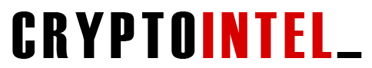
How can we incorporate the power of data science & NLP to assist in information gathering to assess profitable trading opportunities?
CIGT
Data Science & Cryptocurrency Trading
Notes:
The question that I am trying to answer with this project is, ‘how can we incorporate the power of data science and natural language processing to assist in information gathering to assess profitable trading opportunities.
I wanted to create something I could use on a daily basis. I wasn’t confident on my ability of predicting cryptocurrency prices so instead I kept this analysis on Natural Language Processing only. As a trader, I’m looking for an edge when it comes to researching cryptocurrencies that have to potential to move in the direction that will make a profit so I am looking for ways to simplify or amplify my research efforts and datascience can help with that.

Slide 3
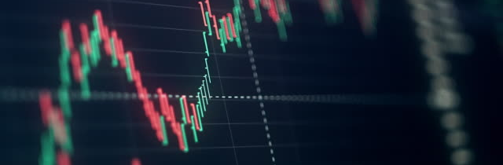
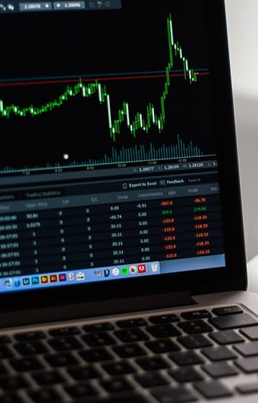
Methods of Application
01
MARKET STRENGTH METER
02
CRYPTO TWITTER STRATEGY
By combining my knowledge in technical analysis and trading with a faster, and more efficient approach of gathering in visualizing data, I have designed 3 different trading strategies, along with a market meter, that will assist in short-to-mid-term investing decisions.
03
CRYPTO CALENDAR
STRATEGY
Data Science & Cryptocurrency Trading
Notes:
For the methods of application. I used a combination of datascience, technical analysis, and social analysis to create 3 trading strategies, two of which I will presenting to you in this presentation along with a market strength meter. It’s important to keep in mind that these tools are for short and mid term investors.

Slide 4

DISCLAMER:
This project will show examples of live trades that I am currently taking. None of this should be taken as financial advice. Everything mentioned is my own personal opinion. Examples presented here should be viewed as educational only.
Notes:
Just a quick disclaimer. I will be showing example of live trades I am currently taking. So none of this is financial advice, this just educational purposes only.

Slide 5
MARKET STRENGTH METER
CIGT
Data Science & Cryptocurrency Trading
Notes:
I will begin with the market strength meter.

Slide 6
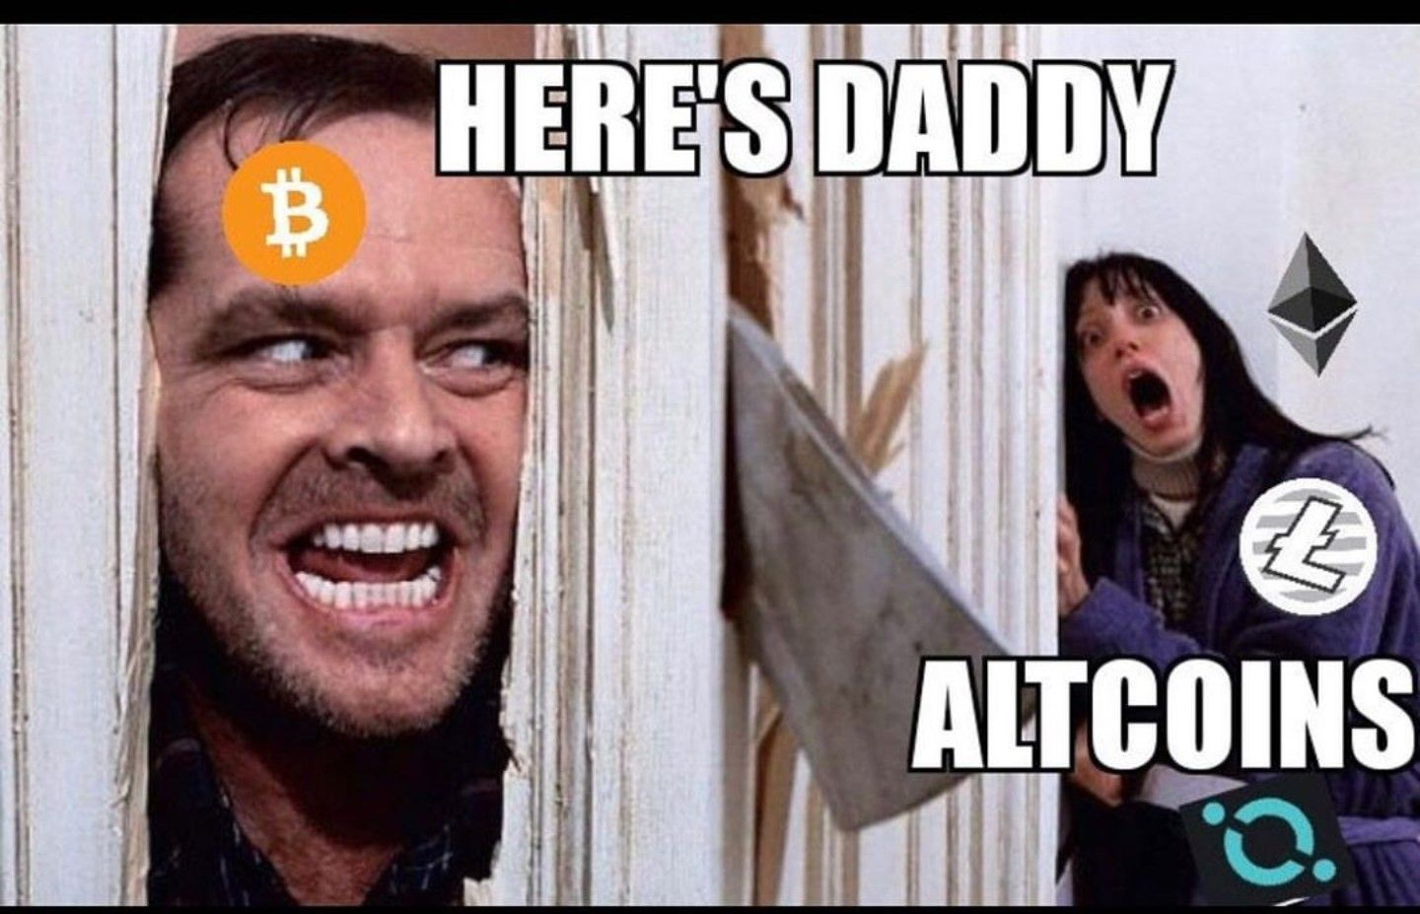
MARKET STRENGTH METER
Data Science & Cryptocurrency Trading
Notes:
So as most of you know, Bitcoin is king. Some of you guys might not agree with that statement. However, it’s through my experience that I have learned that you can have the best set up in the world on an ALT coin and if BTC decides to take a dip, it will ruin your whole set up. This is why I have decided to create a market strength meter to define the best periods of when altcoin trading is more likely to go into a positive direction.

Slide 7

What is a Market Strength Meter & why is it useful?
Python Libraries
Pandas
HVPlot
Pathlib
Numpy
Other Platforms
Bitcoin Dominates About 40% of the Total Crypto Market Cap
Used to Detect Periods of Optimal Day & Swing Trading
Can Help Distinguish Between Bear & Bull Markets
Can Help us from Entering Risky Trades & Taking Unnecessary Losses
Can Help Determine when it’s Time to Lock-In Profits
TradingView
Market Data
Notes:
My market strength meter is used to detect periods of optimal day and swing trading. I don’t believe it trading all of the time. I think it’s a bad strategy to always be in a trade, you want to strategize opportunities of market momentum and also periods of when its better to just stay away from the market. Understand that this tool is for day and swing trading, if you’re a long term investor or a hodler, periods of when the market is down can be used as periods of accumulation. However, for those are short or mid term investors, being able to distinguish between bear and bull markets can help from entering risky trades and taking unnecessary losses.

Slide 8

How does it work?
The Market Strength Meter uses 10 different crypto tickers & market indexes:
(BTC) Bitcoin
(TOTAL) Total Cryptocurrency Market Cap
(TOTAL2) Total Cryptocurrency Market Cap Excluding Bitcoin
(TOTAL3) Total Cryptocurrency Market Cap Excluding Bitcoin & Ethereum
(ETH/BTC) Ethereum against Bitcoin Trading Pair
(BTC3S) 3X Leverage Short BTC Coin On KuCoin
(BTC.D) Ratio Between Bitcoin Market Cap Against the Rest of the Market
(USDT.D) Ratio Between Tether Market Cap Against The Rest of the Market
(ETH.D) Ratio Between Ethereum Market Cap Against the Rest of the Market
(OTHERS.D) Ratio between the market cap of cryptocurrencies excluding large cap alt coins, BTC, & ETH
Notes:
Ok so this is how it works. The Market Strength Meter is based on 10 different crypto tickers and market indexes which you can find on tradingview. I won’t be going through all of them, most of these are self explanatory. A couple which I will mention is the BTC3S, which is a short 3X leverage token on KuCoin. When this coin is pumping, that means Bitcoin is going down and Bitcoin shorts are going up. The tickers that end with the letter D on the right hand column, those are the ratios between that asset’s total market cap against the whole evaluation of the crypto market. That’s Bitcoin dominance, tether dominance, ethereum dominance, and then others dominance which is the rest of the cryptocurrency market excluding large cap alt coins.

Slide 9
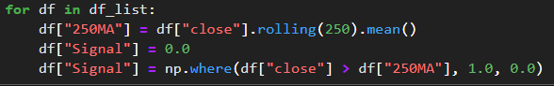
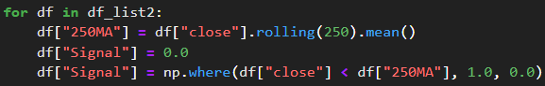
On 12 Hour Chart For Each Ticker
BTC, TOTAL, TOTAL2, TOTAL3, ETH.D, OTHERS.D, ETH/BTC
BTC3S, USDT.D, BTC.D
Closing Price > 250 MA = 1 Point
250 MA > Closing Price = 1 Point
Notes:
I’m using a twelve hour chart instead of the daily chart for this meter and I will explain why in a bit. This is based on a point system out of 10. So in order to get a point, for the tickers on the right hand side, the closing price has to be above the 250MA to get one pont, and that’s for each of the tickers. The tickers on the right handside is the opposite. The 250 MA has to be above the closing price to get the 1 point. And that makes sense because when USDT is pumping, that means most people are holding tether or dollars and not altcoins, same thing for BTC3 Short, when that is pumping, then Bitcoin is going down so it makes sense that you want to see those tickers going down in value to see the alt coin market perform better.

Slide 10
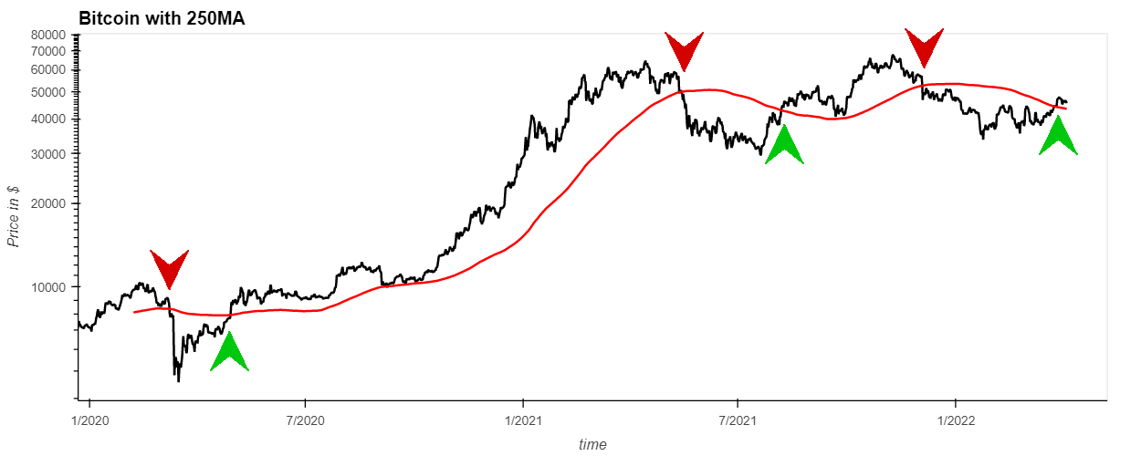
Bitcoin Chart with 250-Moving Average
Closing Price > 250MA = +1 Point (Market Bullish)
Notes:
Here’s a visual example of what I am taking about for Bitcoin. When the closing price crosses over the 250 MA then that’s one point and that’s represented by the green arrows. When the closing price is below 250MA, then that point is lost and we are back at zero. So its either you have 1 point or you have zero points, and that’s for each of the tickers.
You can see how well the 250MA distinguishes between uptrends and down trends, this why I chose the 250MA and the 12 hour chart. We had a recent green arrow, so I am hoping we can stay above the moving average.

Slide 11
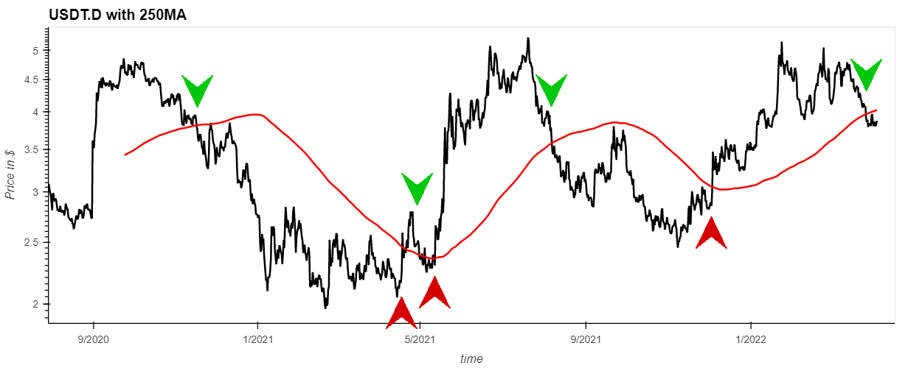
USDT.D Chart with 250-Moving Average
250MA > Closing Price = +1 Point (Market Bullish)
Notes:
This is the tether dominance chart. For this ticker as well as for the bitcoin short token and bitcoin dominance, you want to see the opposite. One point is added when the moving average is above the closing price, instead of below it. So you want to see USDT go down, because that means people are moving away from tether or dollars and are buying crypto currencies.

Slide 12
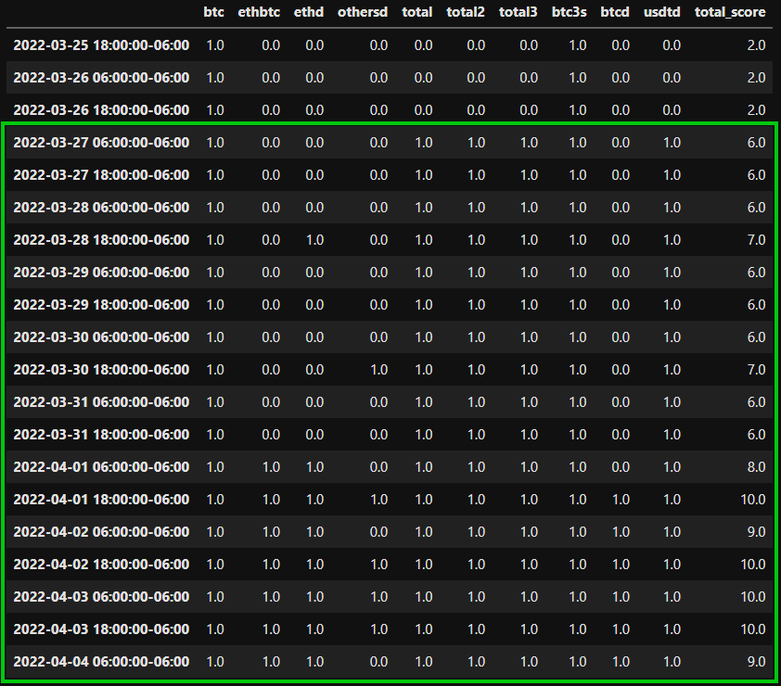
1–3 = BEAR MARKET
4–6 = NEUTRAL MARKET
7–9 = BULL MARKET
10 = TAKE PROFIT
Notes:
In this data frame, I combined all of the scores for each of the tickers for that day and then added them across in the final column labeled total score. You can see there what the total score was for that particular day. On March 27, we started to gain some momentum in the market, and that’s when I began to open up positions. So 1-3 means we are in a bear market, 4-6 the market is neutral, 7-9 we are in a bullmarket, and once we reach ten, the market is over bought so it is time to think about taking some profit off the table if I haven’t done so or atleast move stoploss to break even so that if the market does roll over, I’m still in profit.

Slide 13
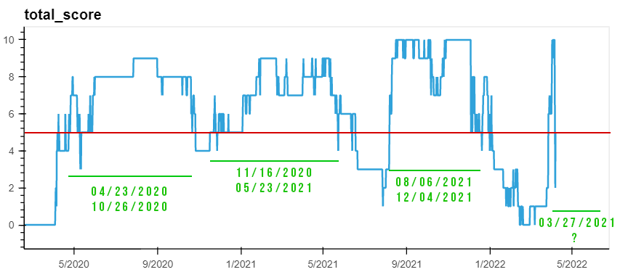
Periods of Optimal Trading
Notes:
This is the historical plot of the market strength meter. Here you can see periods of optimal trading. This includes both altcoin season and bitcoin seasons. The way I use it, when we are above 5, then I’m confident enough to open up new positions. When we are below 5, its best to just lay low and chill out. If you been tracking the market, in the summer of 2021, we had a dip, when the market stayed down from around may to august, and that is represented in the chart. Also the most recent dip that started around Decemberish 2021, and that’s where we have been in up until March 27 of this year. As of today, score is at a 4 so the positions that I have open, I leave open but I’m not opening any new positions

Slide 14
What can be improved on market strength meter?
Use TradingView API to pull data
Optimize Moving Averages that are specific for each market index
Experiment with different time frames to see which one works best for each ticker
Incorporate sentiment data to gain a better understanding of the position of the market
Notes:
What can be improved on the market strength meter? I’m looking into tradingview API. I found one, although its not official, some body created a library and I want to mess around with that and see if I can pull directly from Tradingview. I also want to experiment with different moving average for each of the indexes. Perhaps the 250MA might work very well for Bitcoin, but it might not be the most efficient for others, I have to really dig into it and see if I can optimize that. Also, sentiment data can be analyzed from twitter or google, and find a method to incorporate that into the strength score.

Slide 15
CRYPTO TWITTER STRATEGY
CIGT
Data Science & Cryptocurrency Trading
Notes:
Moving on to the crypto twitter strategy.

Slide 16
Why are tweets important in influencing trading decisions & how to incorporate them into a trading strategy?
v
Python Libraries
Pandas
Twint
Pathlib
NLTK
Re
Counter
Other Platforms
Cryptocurrency projects may post about important events to their users or fanbase
Crypto fans FOMO into a crypto based on significant tweets
Experienced traders frontload news events that will happen in the future
Can increase the chances of successful trade when applying technical analysis
TradingView
Twitter
Notes:
So for this strategy, I’m pulling tweets from cryptocurrency project’s official twitter pages. Sometimes they will post an update about a significant event that’s happening in the future to their followers. The herd buys on this type of news and also traders do as well. What I have seen is that experienced traders will front load the news, so you’ll see a cryptocurrency begin to take off after important announcements are made and then sell off right before the date of the event, so if you wait to buy at the exact date of the event, you’re too late, you’ll catch the top. This why its important to try to gain this information first, before the coin has already pumped. So this is what I am trying to do here.

Slide 17
How does the Crypto Twitter Strategy work?
Coins on the KuCoin Exchange only
over 370 currencies are scraped for their tweet content
That data is then processed and filtered
A list of tweets is generated that can be manually looked over and researched
If coin has significant news, then a trade can be made based on the current technical analysis of that crypto project
Notes:
This is how I use it. Everyday in the morning I’ll scrape for tweets that happened last night or that could have happened over night and early this morning. I do this for over 370 cryptocurrencies that are on the Kucoin Exchange. I then process and filter that information to look for what is relevant to me, and then, I am left with a list of tweets that I can manually look over and see if there is anything that catches my attention to look more into. So essentially, what I am doing here is getting all of the tweets without me having to go one by one to each twitter account, or to be scrolling through all the posts on my twitter feed if I’m subscribed to all those twitter accounts. And then, I’m filtering the noise. I’m removing the tweets that are irrelevant to me, and just keeping the tweets that I may find interesting.

Slide 18

What am I looking for?
Upcoming:
Mobile Apps
Testnets
Partnerships
Mainnets
Roadmap Updates
NFT Marketplace
Launch
Token release, etc.
Notes:
So this is what I am generally looking for. Is a project about to release a new mobile app? Are they going to have a testnet soon? Are they partnering with a big bank or a well known corporation? Are they creating an NFT Marketplace, this is the sort of news that has potential to move the market for that cryptocurrency.

Slide 19
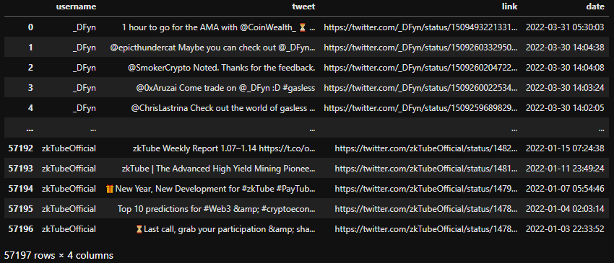
All Tweets From Over 370 Accounts
Notes:
So to begin, I scraped over 57 thousand tweets and placed them in a dataframe.
Before I could begin filtering out the data, I had to decide the best method about how I was going to filter the data.

Slide 20
Manually Picked Keywords
INTEGRATION
TESTNET
UPDATE
APP
MAINNET
PARTNERSHIP
ROADMAP
RELEASE
28 Manually Picked Keywords
Notes:
I began by manually picking some words that I thought were relevant to what I was looking for. Here is a sample of the type of words I wanted to show up in the tweets. I ended up with about 28 words.

Slide 21

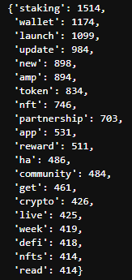
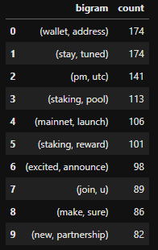
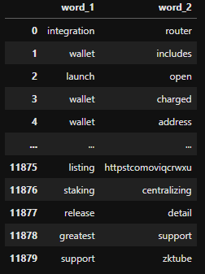
Tokenize
Filter & Sort
Create Bigrams
Notes:
then I went through the dataframe that contained all of the tweets and I tokenized and removed all of the generic stop words. Then I created bigrams out of the tokenized words and ended up with over 11 thousand bigrams. To consolidate the data further I brought the keywords that I manually picked and used that to filter out the bigrams and then I sorted the list of bigrams by the most mentioned. I now had a list of bigrams that were specific to what I was looking for

Slide 22
Bigram Keyword Filter
INTEGRATION
APP LAUNCH
TESTNET
UPDATE
TESTNET LAUNCH
APP
MAINNET
ROADMAP UPDATE
COMING SOON
PARTNERSHIP
ROADMAP
MAINNET RELEASE
RELEASE
PARTNERSHIP
ANNOUNCEMENT
28 Manually Picked Keywords
65 Bigram Relevant Keywords
Notes:
I ultimately went from having 28 manually picked keywords to 65 bigram keywords that I could use to filter out the tweets and keep only the tweets that were relevant to what I was looking for.

Slide 23
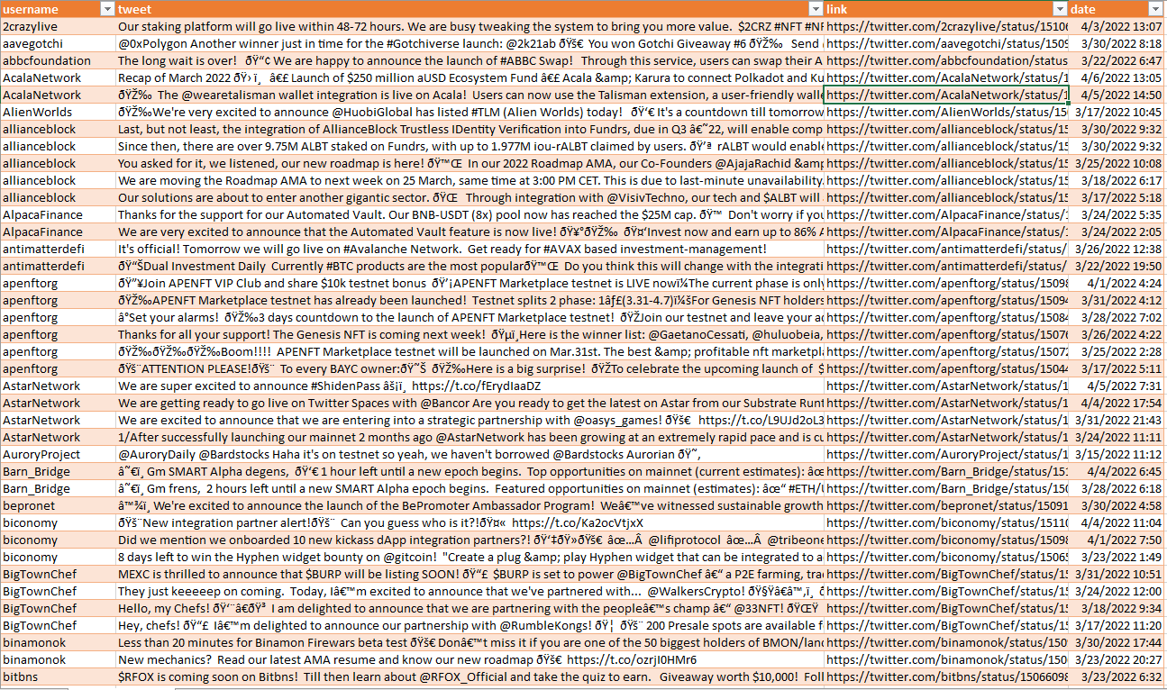
Notes:
After I filtered the tweets, I ended up with a list of tweets which I then exported into a csv file with the URL attached so that I could look over and click on the tweets that I thought were interesting to me.

Slide 24

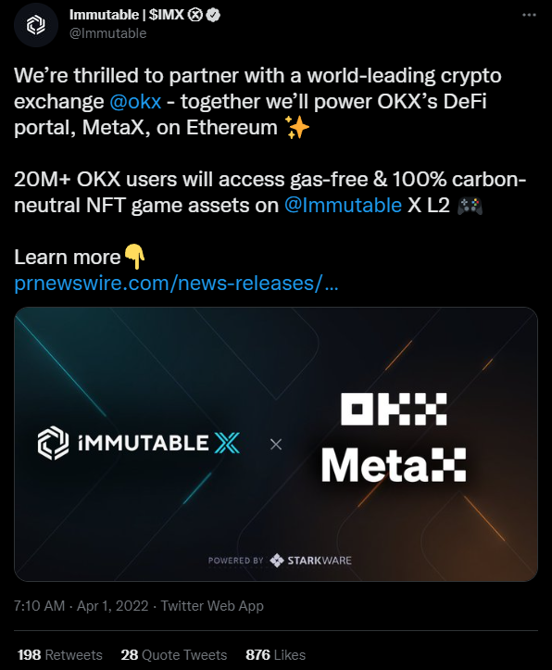
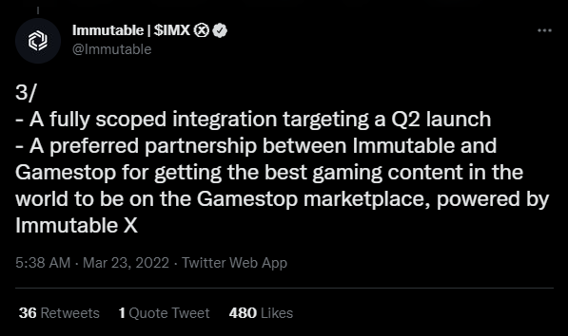
Immutable (IMX)
Notes:
This is a project that I thought had significant news. Immutable X has a partnership with OKX to provide gas free 100% carbon Neutral NFT game assets on the Immutable platform. They’re also working on a partnership with gamestop for providing gaming content.

Slide 25
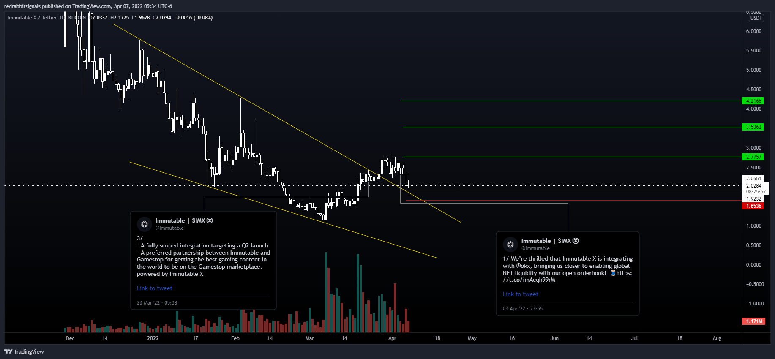
Notes:
So I pulled up the chart, this is IMX on the daily. Here there is a falling wedge that broke out and now its retesting the pattern. I also posted the tweets so that you can see when they got posted. The point I’m trying to make is that its not favorable to just buy when the posts are tweeted. You have to apply technical analysis to find a good entry point so that you’re not going in the trade blind. Right here on this retest of the pattern is a good entry for me here so I took entry inbetween the white lines.

Slide 26
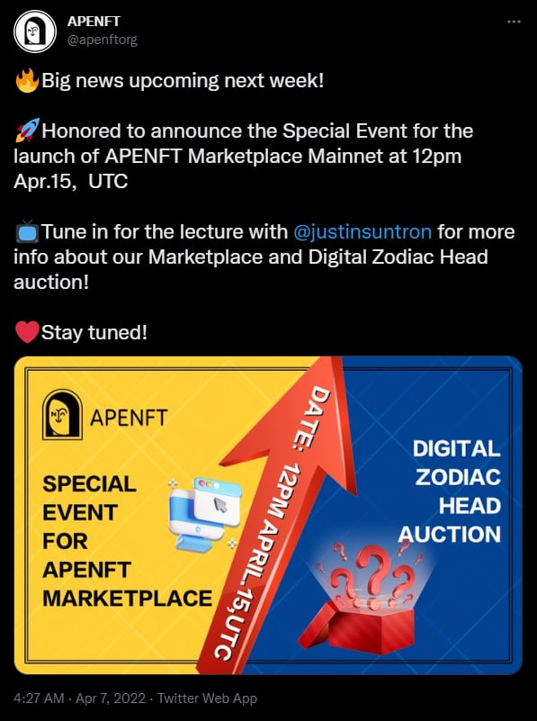
APENFT (NFT)
Notes:
This is APENFT and they’re having a NFT Marketplace Mainnet coming up on April 15. These are the type of events I’m looking for when I’m searching for project news.

Slide 27
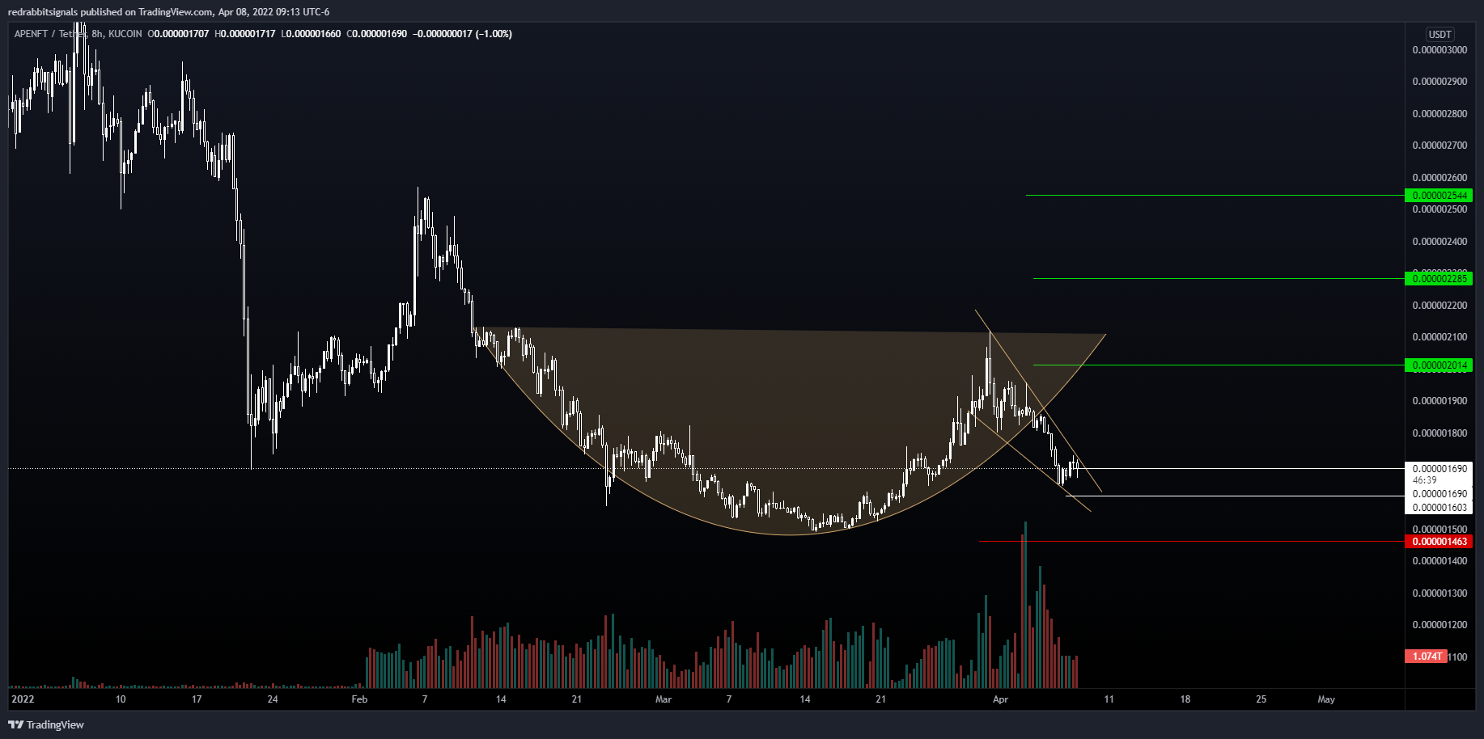
Notes:
I pull up the chart here and I see potential for a nice cup and handle pattern forming. I front loaded the falling wedge and took entry at the bottom of the wedge. I make sure to set a stop loss and take profit levels way before I enter a trade.

Slide 28
What can be improved on the Crypto Twitter Strategy?
Keyword Bigram Selection can be improved to filter the noise even further
Deployed to a virtual server or AWS to run 24/7 and return tweets as they are posted
More research on the relationship between tweet news and price movements
Instead of using the keyword filter, I can filter by the number of likes
Notes:
Things that I can improve or try out. I can improve the keyword bigram selection by removing or adjusting words to filter out more of the noise. I would like to find a way to run this on a server so that its running all of the time and have the content sent back to me as soon as its posted to twitter. I’m looking to find more relationships between tweet news and price movements, maybe even create a machine learning model that could help me determine what news is more likely to produce a positive outcome. I also thought of filtering by the number of likes and see what looks like.

Slide 29
CRYPTO CALENDAR STRATEGY
Data Science & Cryptocurrency Trading
Notes:
Last but not least, the crypto calendar strategy.

Slide 30
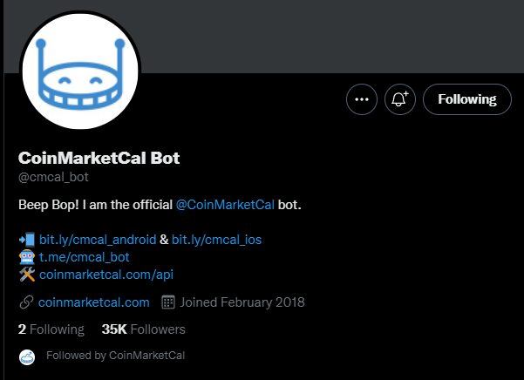
How does the Crypto Calendar Strategy work?
Coins on the KuCoin Exchange only
Coin Market Cap Twitter Bot is scraped for all new events
That data is then processed and filtered
A list of tweets is generated that can be manually looked over and researched
If coin has significant news, then a trade can be made based on the current technical analysis of that crypto project
Notes:
So this is basically the same as what I did for the twitter strategy except this time, instead of scraping individual accounts, I’m srapping the coin market cal twitter bot that posts news events as they are posted on the coinmarketcal website. For those who don’t know. Coinmarketcal is a calander that keeps record of cryptocurrency events that are added to its platform. It’s very useful, however it doesn’t catch all of the events, and you also have to wait until they are listed on to their platform to get the news. But its still useful because a lot of traders use this site to find out about current events and so its good to stay on top of what they put out.

Slide 31

REMOVING THE NOISE
Community Calls
AMA’s
YouTube Streams
IG Live
Twitter Spaces
Conference
Summit
Whitepaper
Notes:
For this one, instead of finding keywords that I wanted to keep to filter through the data, I instead did a list of keywords that I didn’t want the dataframe to contain like AMA’s, live streams, conferences. Those events usually do not do anything to price of the cryptocurrency in my opinion and I thought this would be a much easier way to filter out the noise.

Slide 32
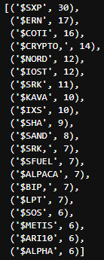
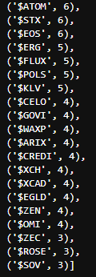
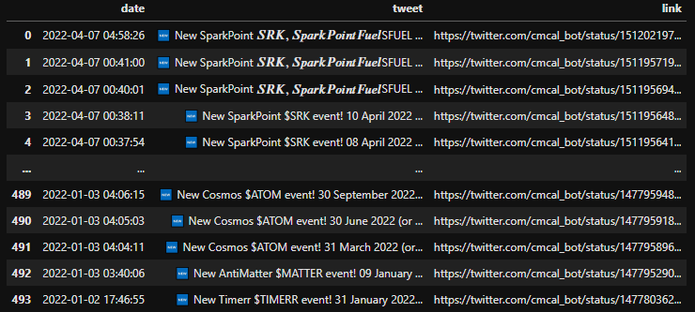
Processed & Filtered Events
Notes:
I processed the data and filtered the events. This is what I ended up with. I was able to get a list of cryptocurrencies that I could sort and find the ones that had the most events listed.

Slide 33
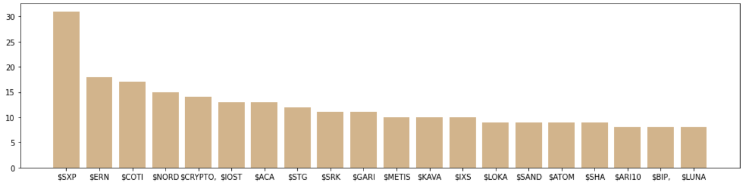
Cryptocurrencies With The Most Events
Notes:
This is a visualization of the data. Its important to note that just because a cryptocurrency has a lot of events listed doesn’t necessarily mean that’s a good coin to invest. I still have to look through them and make sure the events are still relevant and that they haven’t already passed their due date.

Slide 34
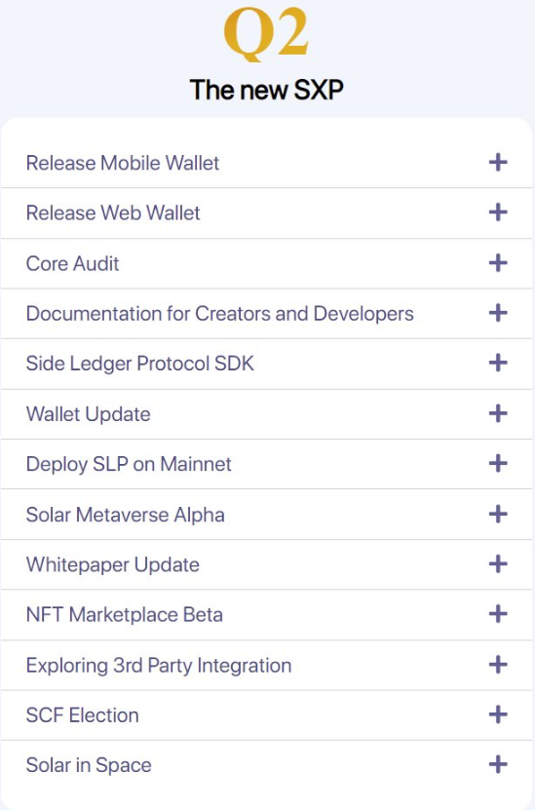
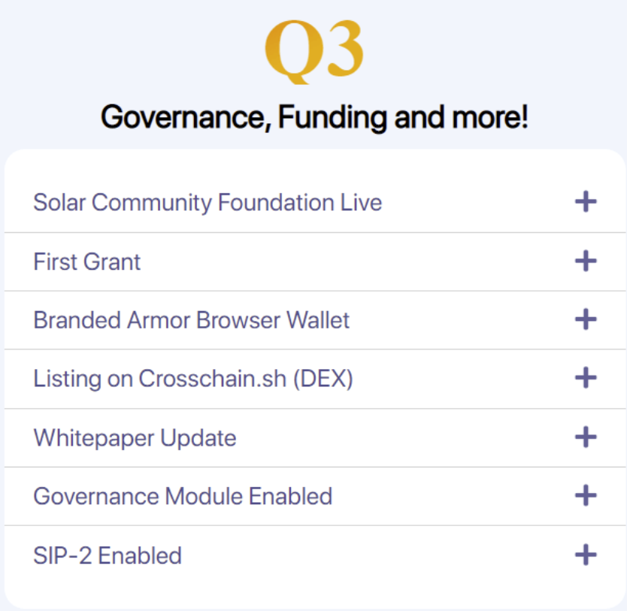
Solar Network (SXP)
Notes:
I pulled up all the events for SXP and they are stacked for Q2 & Q3. If Bitcoin stays on trend or moves side ways for a while, this will allow for SXP to grow.

Slide 35
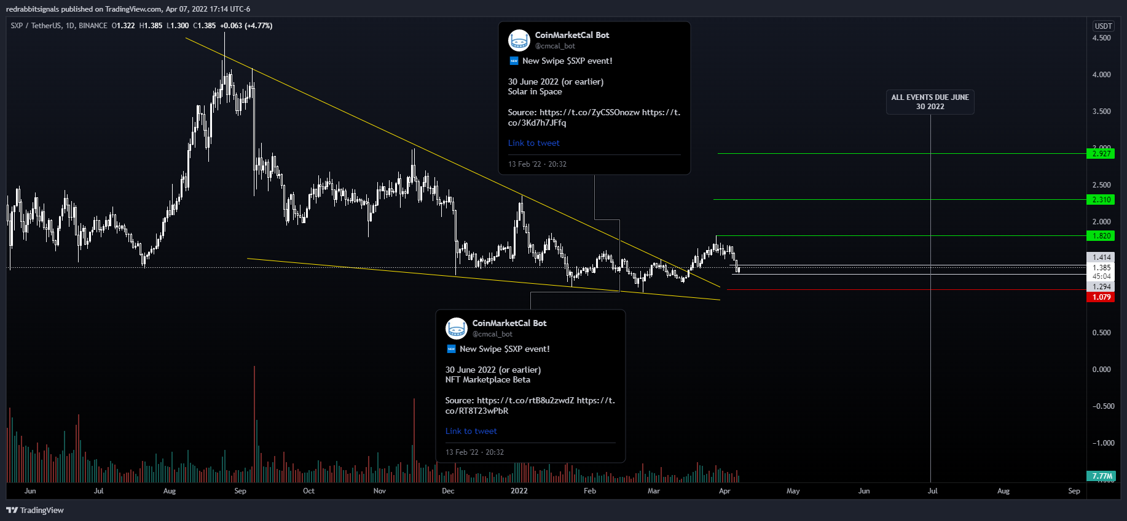
Notes:
Here is the daily chart for SXP. A breakout of the falling wedge and retest of support is a good entry so I took it with 10x leverage

Slide 36
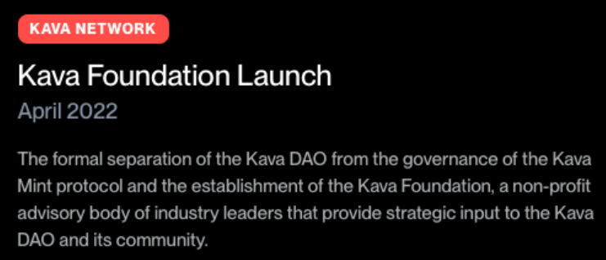
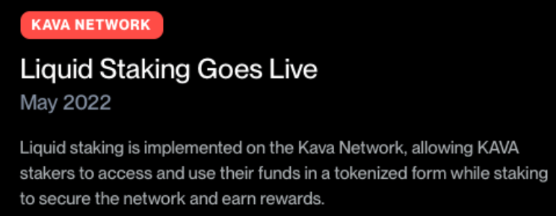
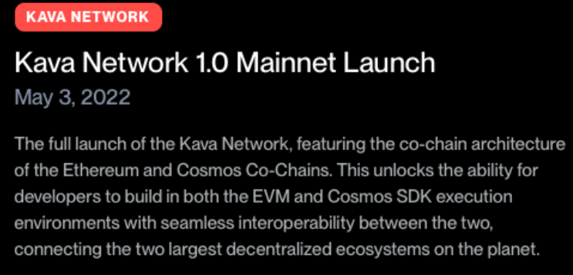
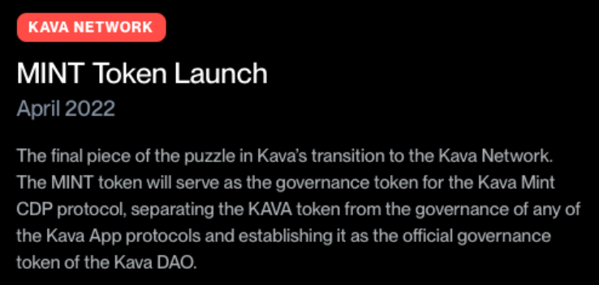
Kava Network (KAVA)
Notes:
Here is another one that is stacked with news. This is KAVA network. There more events coming than just the ones here. I think KAVA will be performing well for Q2

Slide 37
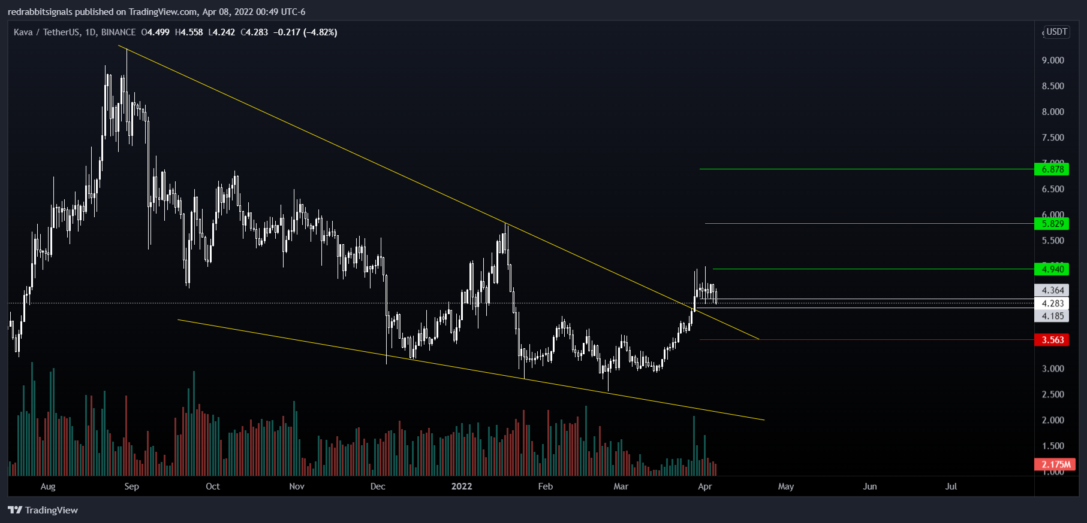
Notes:
Here is their chart and where I took entry. This one is actually already in profits for me.

Slide 38
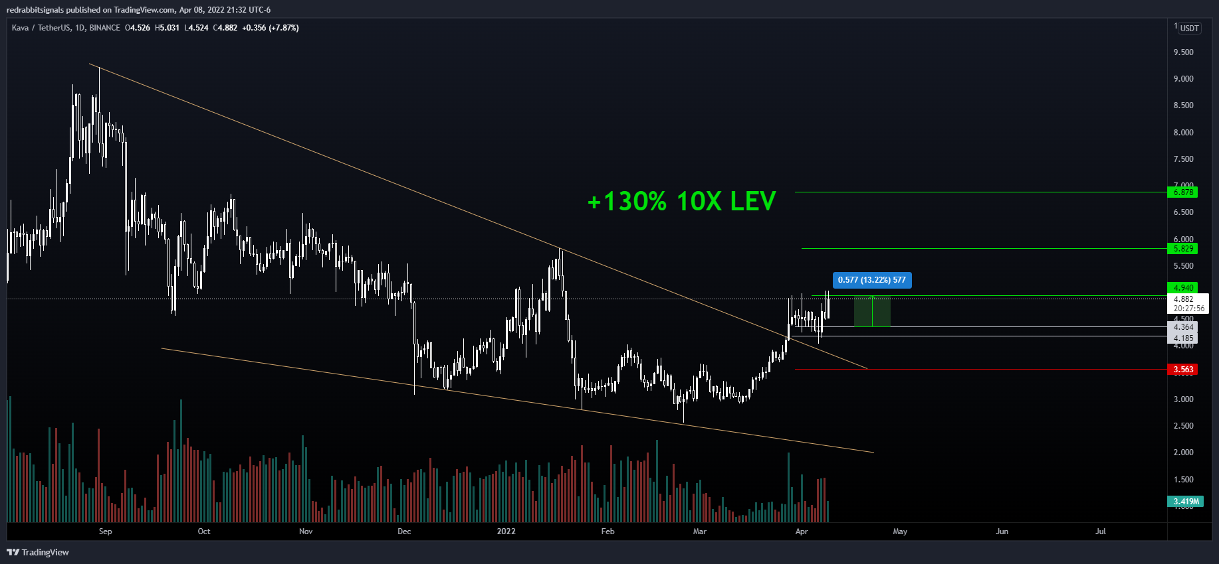
Notes:
I’m up over 130% on this trade. I entered with 10X leverage.

Slide 39
What can be improved?
Deployed to a virtual server or AWS to run 24/7 and return tweets as they are posted
Discover relationship between listings on other exchanges
Expand beyond KuCoin exchange and experiment with lower cap coins traded on decentralized exchanges
Researching other cryptocurrency calendar platforms that can be scraped
Notes:
For the moment, I’m only working with coins that are listed on KuCoin but I’m looking into also trying to get into BSC and ERC 20 tokens listed on decentralized exchanges. I also am looking into coins that are on KuCoin that get listed on other exchanges and what the relationship of those listing events is against the price movement. There are also other cryptocurrency calendars that I plan on looking into to gather more information.

Slide 40
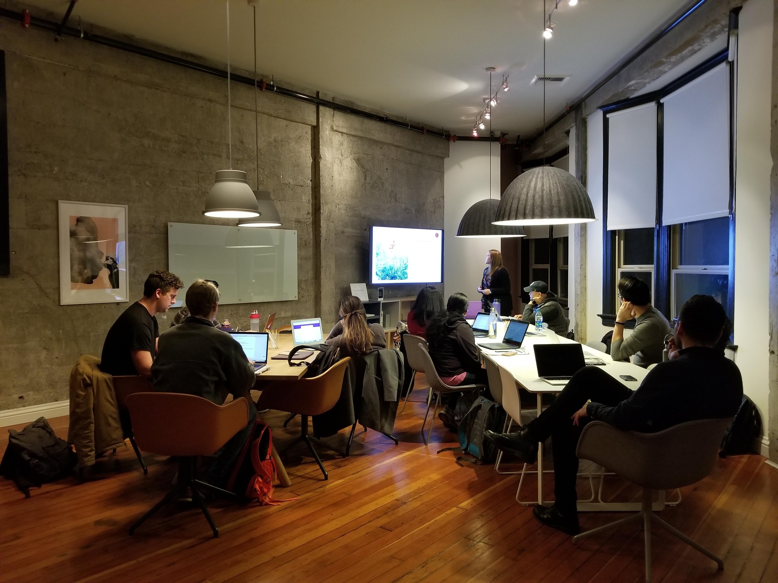



Looking for a group of guys & gals!
Jorge David Betancourt
Current Ideas & Future Projects:
Reddit API or Scraper
Telegram API or Scraper
Discord
Algorithmic Trading Strategies
Finding Low Cap Gems
Meme Coin Development
DAPPs Development
NFT Development
Technical Analysis
Signal Service
Trading Dashboard
@davidcrypto0
To Keep Track of Trades Taken in this Project
@cryptointelgathering
Notes:
I’m looking for a group of guys and gals that would like to team up and work on some of this stuff together. If you found anything that I did interesting and would like to join me on expanding and incorporating other ideas then hit me up. I’m looking for individuals that are good at technical analysis, fundamental analysis, that are good at finding micro crap currencies, machine learning, and all the stuff that we have been learning in this class, also those who are interested in blockchain development. You can
DM me on slack or message me on telegram. Also, if any of you guys are interested on how the trades that I took for this project are playing out, you can follow my telegram channel.

Slide 41


THANK YOU FOR YOUR ATTENTION!
ANY QUESTIONS, COMMENTS, SUGGESTIONS?
Notes:
Thank you guys, do you have any questions, comments, suggestions?

